Slide 2
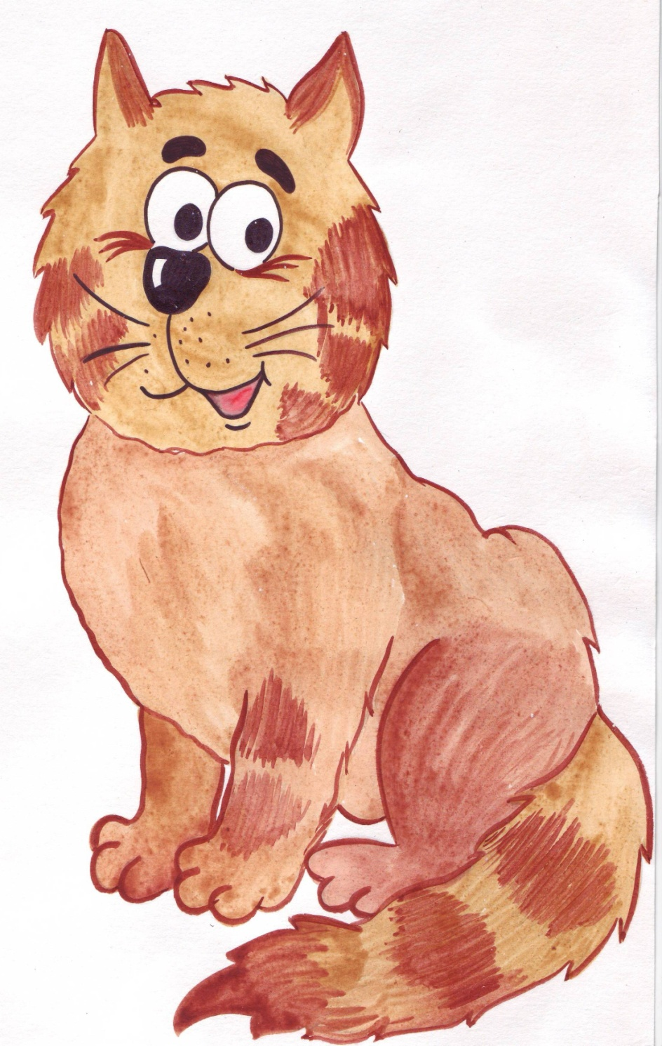

A super cat
My cat can sing, my cat can walk,
My cat can watch TV.
My cat can do so many things
And it can play with me!
My cat can’t play computer games
And can’t sit on my bed.
But all in all
But all in all
It is a supper cat!

Slide 3
Play Football

Slide 4
Play tennis

Slide 5
Run

Slide 6
Play the piano

Slide 7
Walk

Slide 8
Dance

Slide 9
Read

Slide 10
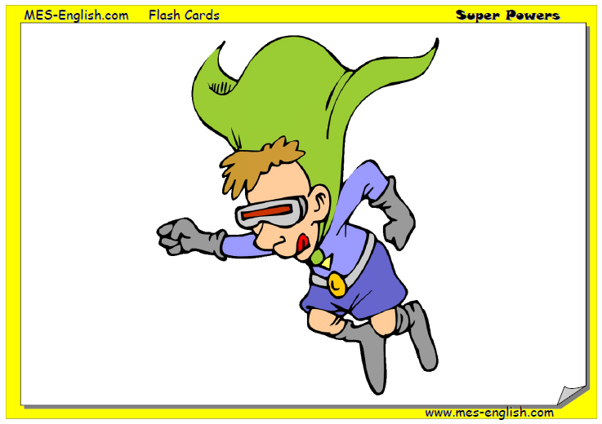
fly

Slide 11
Write

Slide 12
Jump

Slide 13
Watch TV

Slide 14
Play computer games

Slide 15
Sing

Slide 16
Speak

Slide 17
Ride a bike

Slide 18
Swim

Slide 19
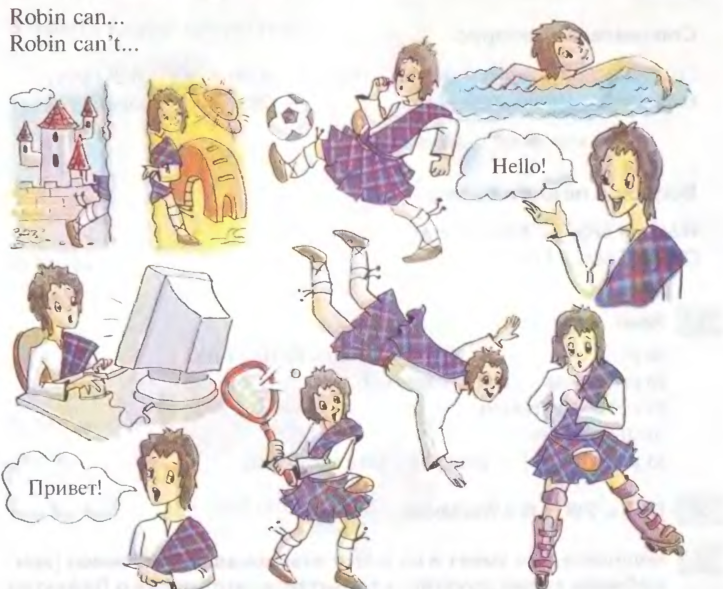

Slide 20
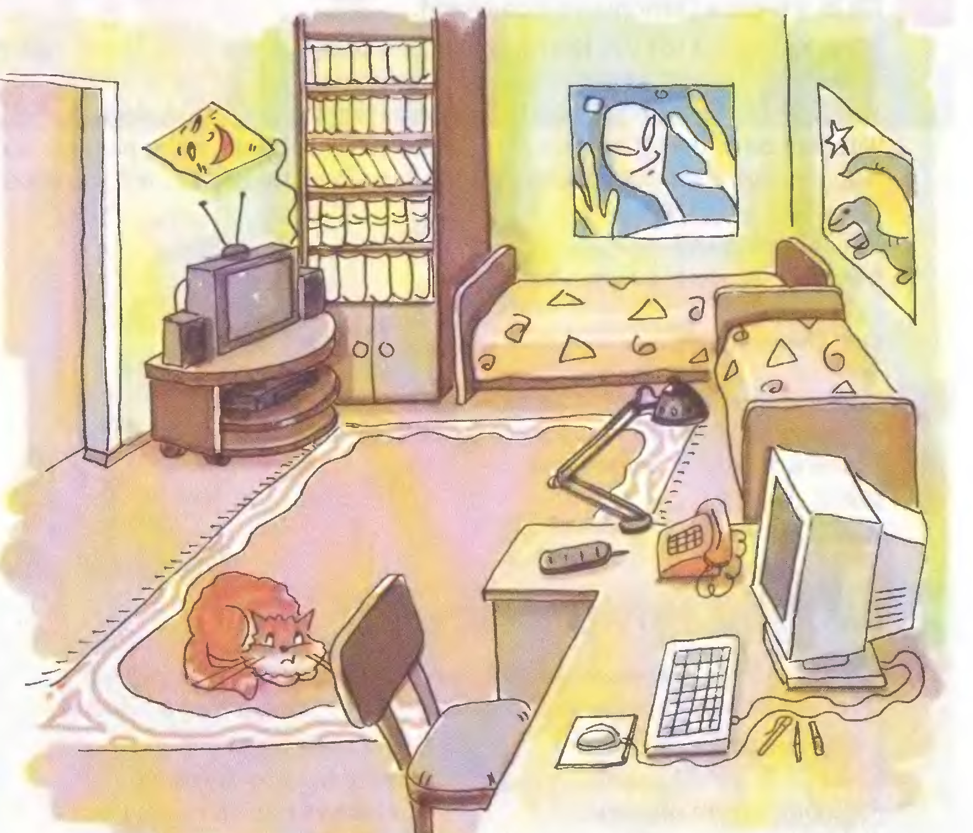

Slide 21
